Slide 1
Linux basics and bash scripting
Part 3
Based on https://michael-herbst.com/teaching/advanced-bash-scripting-2017/

Slide 2
Subshells and functions
Chapter 6

Slide 3
Explicit and implicit subshells - Grouping commands
Multiple commands can be grouped using the syntax
• Both the space in the beginning as well as the ; in the end are crucial.
• The ; may — as usual — be replaced by a line break, however.
• All commands in the list share the same stdin, stdout and stderr.
• The return code is the return code of the last command in list .

Slide 4
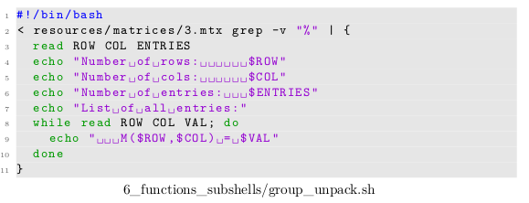
Explicit and implicit subshells - Grouping commands
The syntax is e.g. useful for
• unpacking data
Output in next slide

Slide 5
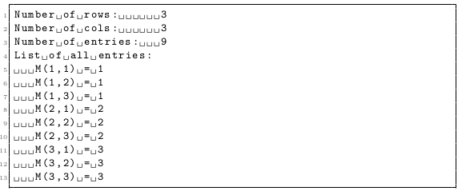
Explicit and implicit subshells - Grouping commands
output:

Slide 6
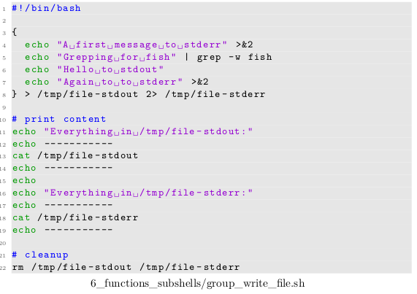
Explicit and implicit subshells - Grouping commands
• sending data to a file
Output in next slide

Slide 7
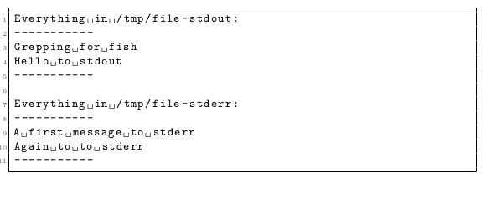
Explicit and implicit subshells - Grouping commands
Output:

Slide 8
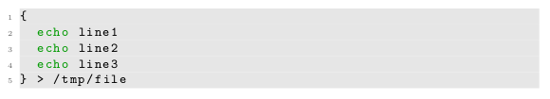

Explicit and implicit subshells - Grouping commands
• There surely are alternative ways in order to write many lines of data to a file. For example instead of
we could also use

Slide 9
Explicit and implicit subshells - Grouping commands
The latter method has a few disadvantages, however:
• One easily forgets one of the >> or > operators at the end.
• One easily mixes up > and >> when writing the code, such that some of the stuff gets accidentally overwritten.
• If we want to rearrange the order in which the data gets written at any later point, we need to be careful to change the > and >> redirects in a consistent manor as well. One easily forgets this.

Slide 10
Explicit and implicit subshells - Making use of subshells
Subshells are special environments within the current executing shell, which work very similar to command grouping
Their special property is that all changes to the so-called execution environment are only temporary.
The execution environment includes
• The current working directory
• The list of defined variables and their values

Slide 11
Explicit and implicit subshells - Making use of subshells
Once the subshell exits all these changes are undone, i.e. the main shell’s execution
environment is restored. Invocation syntax:
• All commands in the list share the same stdin, stdout and stderr.
• The return code is the return code of the last command in list .
• All changes the subshell makes to the execution environment are only temporary
and are discarded once the subshell exits.

Slide 12
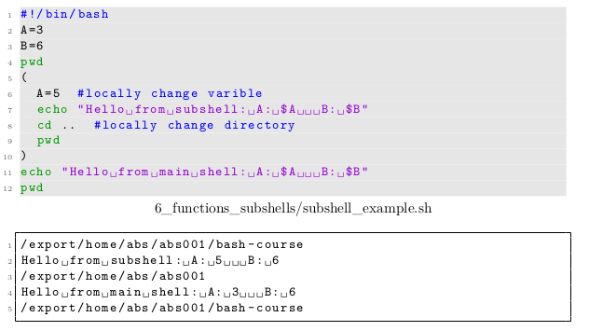
Explicit and implicit subshells - Making use of subshells
Example

Slide 13
Explicit and implicit subshells - Making use of subshells
Subshells are particularly useful whenever one wants to change the environment and knows that this change is only intended to last for a small part of a script
This way cleanup cannot be forgotten.
Example in next slide

Slide 14
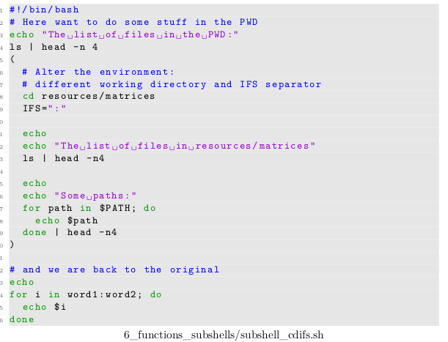
Explicit and implicit subshells - Making use of subshells
Example
Output in next slide

Slide 15
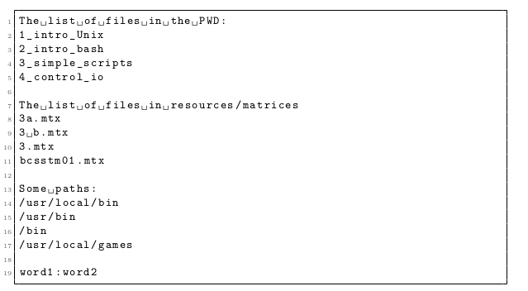
Explicit and implicit subshells - Making use of subshells
output

Slide 16
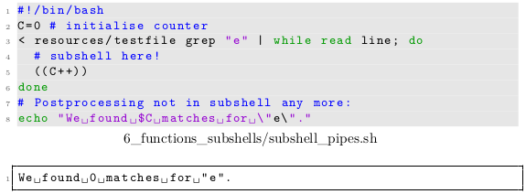
Explicit and implicit subshells - Implicit subshells
Apart from the explicit syntax discussed above, the following situations also start a subshell implicitly
• Pipes: This is done for performance reasons by the bash. Forgetting about this is a very common mistake:

Slide 17
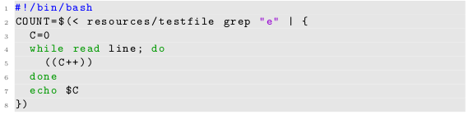

Explicit and implicit subshells - Implicit subshells
A workaround for this problem is to run everything that needs to access the variable C as a group and cache the output using a command substitution:

Slide 18
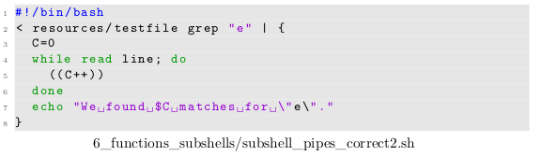
Explicit and implicit subshells - Implicit subshells
If the post-processing can be done inside the command group as well, like in this simple case, we could alternatively do

Slide 19
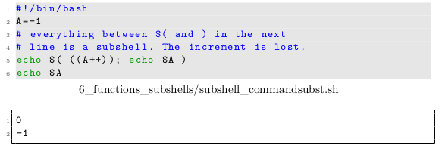
Explicit and implicit subshells - Implicit subshells
• Command substitutions: Usually less of a problem

Slide 20
Explicit and implicit subshells - Implicit subshells
• Since command substitutions starts a subshell, one might wonder how we could extract multiple results from a single command substitution.
• Unfortunately there is no simple way to do this, since all changes we make to variables inside the $( ... ) are lost.
• We only have stdout, which we can use to retrieve data in the main shell from the executed commands.

Slide 21
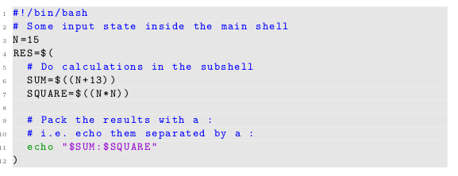
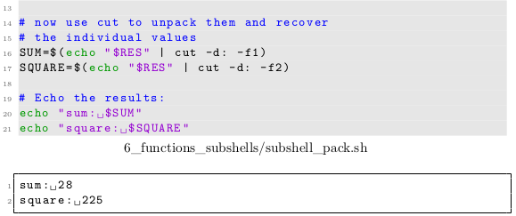
Explicit and implicit subshells - Implicit subshells
The solution to this problem
Is to pack the data
inside the subshell
and to unpack it later, e.g.

Slide 22
Exercise!
Exercises 6.1 - 6.2

Slide 23
bash functions
The best way to structure shell code by far are bash functions. Functions are defined like
Or

Slide 24
bash functions
and essentially define an alias to execute list by the name of name . Basic facts:
• Functions work like user-defined commands.
• We can redirect and/or pipe stuff from/to them. As with scripts or grouped commands, the whole list shares stdin, stdout and stderr.

Slide 25
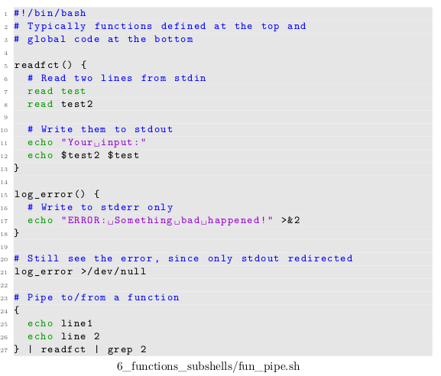
bash functions
Example:
Output in next slide

Slide 26

bash functions
Output:

Slide 27
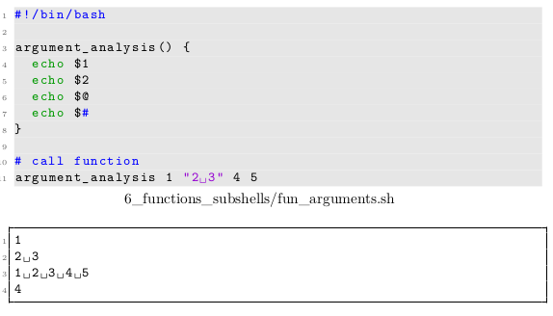
bash functions
• We can pass arguments to functions, which are available by the positional parameters

Slide 28
bash functions
• Inside a function the return command is available, which allows to exit a function prematurely and provide an exit code to the caller.
• If no return is used, the last command in list determines the exit code.
Example in next slide

Slide 29
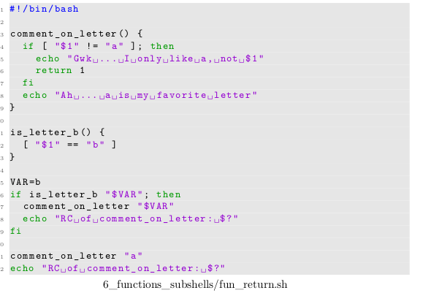
bash functions
Example
Output in next
slide

Slide 30
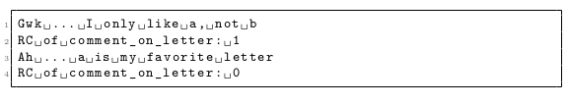
bash functions
Output

Slide 31
bash functions
• All variables of the calling shell are available inside the function.
• They may not only be read, but also modified. If the version fun() { ... } is used, this modification is global, i.e. effects the shell variables of the caller as well.
• To circumvent this issue a variable inside a function may be defined as local.
• In this case they are only available to the function and all its children,
• i.e. other functions which may be called by directly or indirectly 2 by said function. The global state of the caller is not effected.
⇒ One can think of functions as small scripts within scripts.

Slide 32
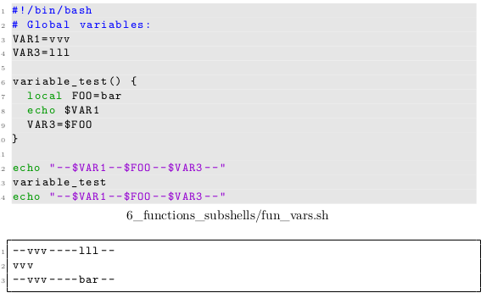
bash functions
Example:

Slide 33
Exercise!
Exercise 6.3

Slide 34
Good practice when using functions
A couple of helpful notes for writing functions, which are easy to understand and easy to use.
• Give functions a sensible and descriptive name.
• Put a comment right at the top of the function definition, describing:
– what the function does
– what the expected argument are
– what the return code is
• Do not trust the caller: Check similar to a script that the parameters have the expected values
• Do not modify global variables unless you absolutely have to. This greatly improves the readability of your code.

Slide 35
Good practice when using functions
• Use local variables by default inside functions.
• Have functions first, then “global code”
• Try to define functions in an abstract way. This makes is easier to reuse and
expand them later.
• It usually is a good idea to have functions only return error codes and print error messages somewhere else depending on the context.

Slide 36
Good practice when using functions
Compare the following shell scripts in your directory,
Both display some basic information of an mtx file.
Decide for yourself what is more readable
6_functions_subshells/fun_bad.sh
6_functions_subshells/fun_good.sh

Slide 37
Exercise!
Exercise 6.4 - 6.5

Slide 38
Overwriting commands
At the stage of execution the bash gives preference to user-defined functions over builtin commands or commands from the operating system.
This implies that care must betaken when naming your functions, since these can “overwrite” commands
which may lead to very surprising results - example in next slide

Slide 39
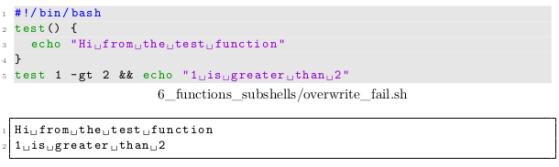
Overwriting commands
Example:

Slide 40
Overwriting commands
Since commands within a function are of course subject to the same evaluation strategy by the bash as “free” commands in the script, accidental overwriting of commands can lead to very subtle infinite loops:
Example in next slide

Slide 41
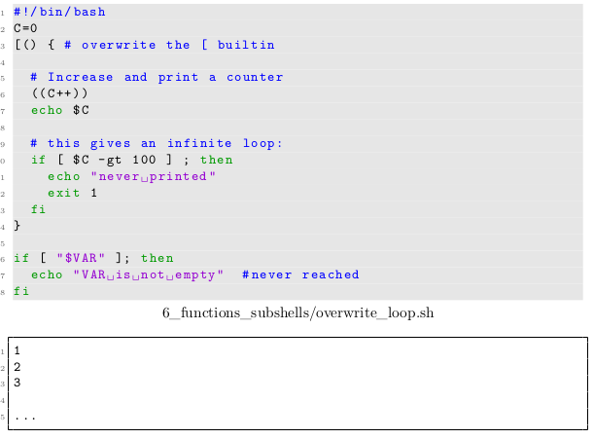
Overwriting commands
Example

Slide 42
Overwriting commands
In scripts it is best to avoid this for overwriting builtins or system commands, since it can make code very cumbersome and hard to understand.
For customising your interactive bash, however, this can become very handy
Another very handy use case for this is to dynamically change the meaning of a function during the execution of a script.
This works, since the bash only remembers the most recently defined body for a particular function name

Slide 43
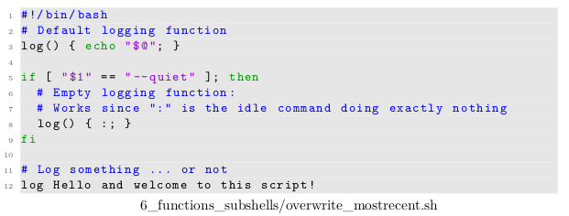
Overwriting commands
A good example for using this is logging:
Without “--quiet” the script prints
With “--quiet” all log calls are essentially ignored.

Slide 44
Cleanup routines
Using subshells it becomes easy to temporarily alter variables or the working directory and have these changes “automatically” changed back to the original — no matter where and how the subshell exited.
Especially for larger scripts this helps to prevent many errors.

Slide 45
Cleanup routines
Sometimes it would be nice to be able to do more than that in case a script exits or gets interrupted.
Consider the example in the next slide, where we need a temporary file to store some intermediate results

Slide 46
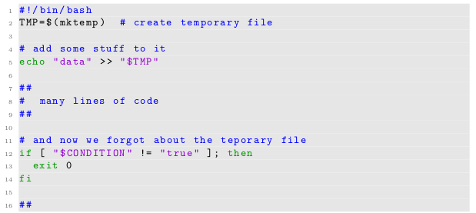
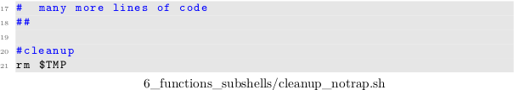
Cleanup routines
Example

Slide 47
Cleanup routines
Especially when programs get very long (and there are many exit conditions) one easily forgets about a proper cleanup in all cases.
For such purposes we can define a routine that gets executed whenever the shell exits
Example in next slide

Slide 48
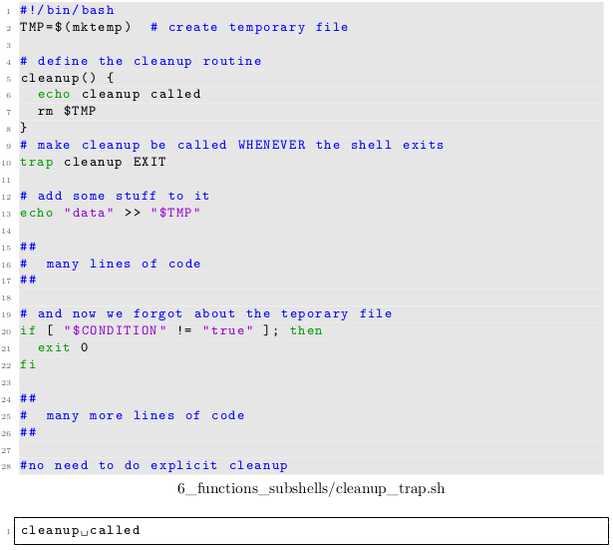
Cleanup routines

Slide 49
Making script code more reusable
Ideally one wants to write code once and reuse it as much as possible.
This way when new features or a better algorithm is implemented, one needs to change the code at only a single place
For this purpose the bash provides a featurecalled sourcing.
Using the syntax

Slide 50

Making script code more reusable
a file otherscript can be executed in the environment of the current shell, i.e. just like copying the full content of otherscript at precisely the location of the call.
This implies of course that all variables and functions defined in otherscript are also available to the shell afterwards.
An example: (Continued on next slide)

Slide 51
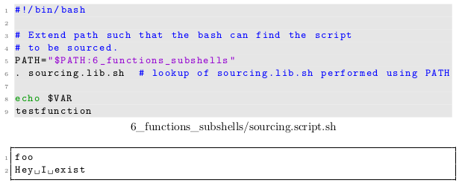
Making script code more reusable
Example cont.

Slide 52
Making script code more reusable
In order to find otherscript the bash honours the environment variable PATH.
As the example suggests this way libraries defining common or important functionality may be stored in a particular library directory and used from many other scripts located in very different places by adding this library directory to the PATH environment variable.

Slide 53
Making script code more reusable
On top of that there exists a dirty trick to make each script sourcable by default, such that functions or global values inside the script may be used by other scripts at a later point in time.

Slide 54
Making script code more reusable
The trick relies on the fact that the return statement is only allowed in files, which
are sourced, but not in scripts which are executed normally
That way one can distinguish inside the script and separate function definitions and “global code” — to be executed in all cases — and code, which should only be touched if a script is not just sourced, but properly executed.

Slide 55
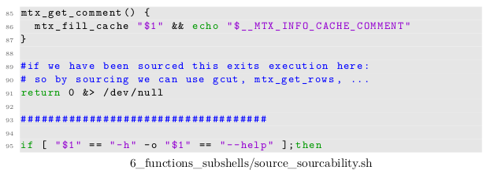
Making script code more reusable
For the script fun_good.sh presented earlier , we just add a
after the function definitions:

Slide 56
Exercise!
Exercise 6.6

